Slide 1

CS3383
Good Bug Reporting
Bug Tracking Procedures
Week 7 Lecture

Slide 2



Bug Tracking Systems
Bugzilla
  http://www.bugzilla.org/
Mantis
  http://www.mantisbt.org/
Trac
  http://trac.edgewall.org/
Reference
  http://www.thegeekstuff.com/2010/08/bug-tracking-system/

Slide 3
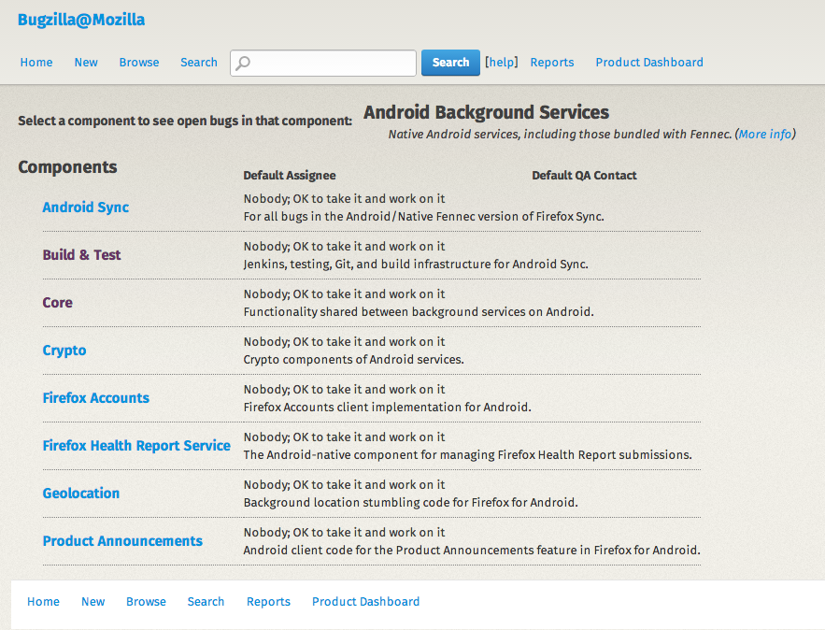
Bugzilla
Example: Android Background Services
  https://bugzilla.mozilla.org/describecomponents.cgi?product=Android%20Background%20Services

Slide 4
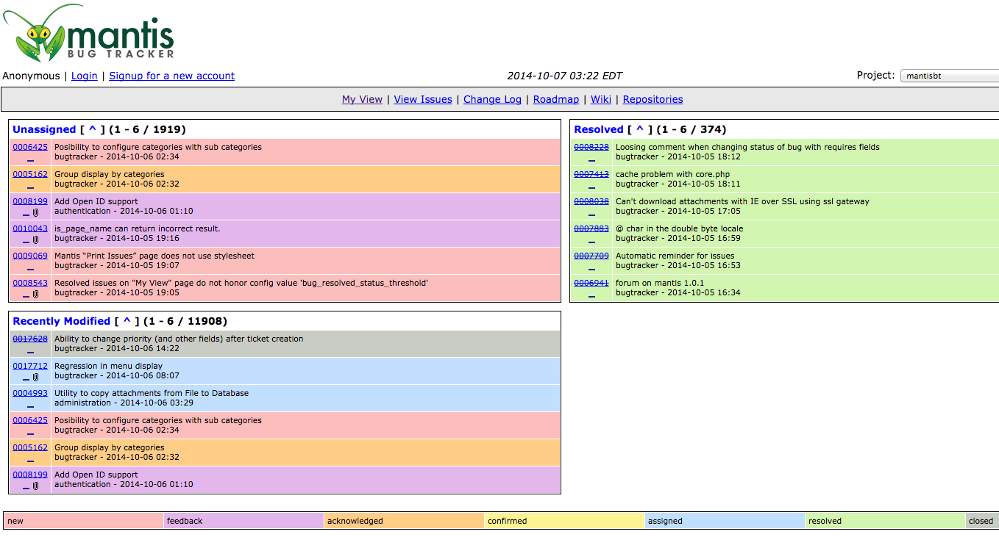
Mantis Bug Tracking

Slide 5
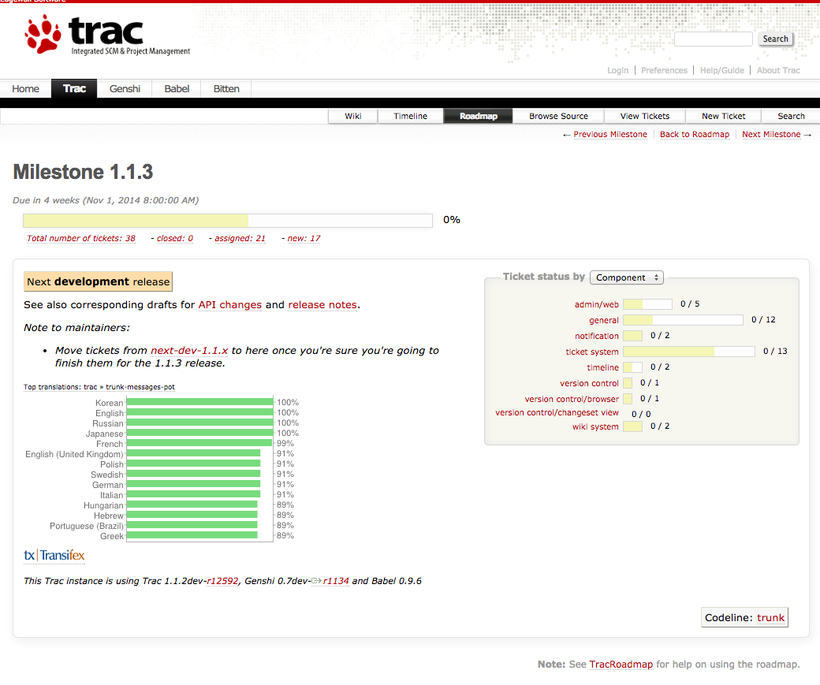
Trac

Slide 6


Sample Bug Report 1
Title: Windows 7 Data Loss
Description: Left-over file may cause settings, files to be lost
Vendor: MS Product: Win 7 Versions: Windows 7 Home Edition
Severity: Urgent Updated 3/28/2020
Status: Outstanding
Problem:
On Lenovo X300s notebook where Windows 7 was pre-installed at the factory, a left-over file may cause data loss if an in-place upgrade or installation is later done using a MS Windows Update service. The user settings that may be lost include things such as shortcuts, Startup items, and files in the Documents folder. We do expect that these files are not affected by any upgrade.

Slide 7
Sample Bug Report 2
(Web Application Context)
Title: Login button remains disabled after entering valid credentials
Application Version: v2.4.1
Browser: Google Chrome v118.0.5993.88
Operating System: Windows 11
Steps to Reproduce:
1. Navigate to Login webpage
2. Enter a valid email address in the “Email” field (e.g., user@example.com )
3. Enter a valid password in the “Password” field (e.g., SecurePass123!)
4. Observe the “Login” button
Expected Behavior: The “Login” button should become enabled as soon as both fields contain valid input, allowing the user to submit the form.
Actual Behavior: The “Login” button remains disabled even after valid credentials are entered. Clicking the button has no effect.
Severity: High

Slide 8
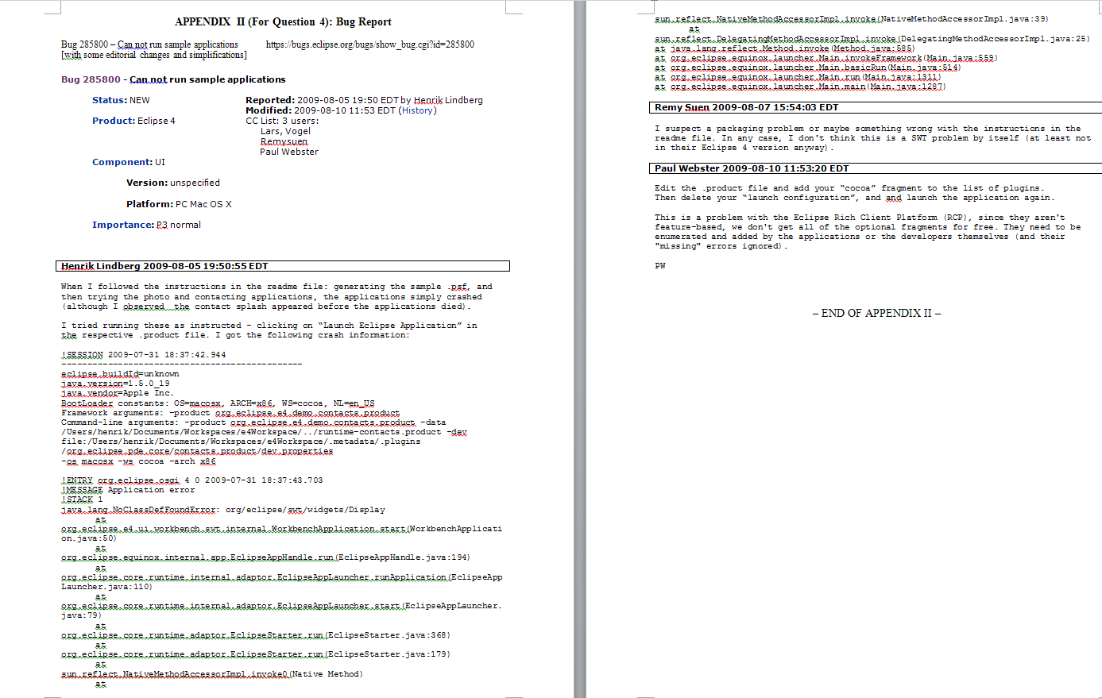
Bug Report in Past Exam

Slide 9
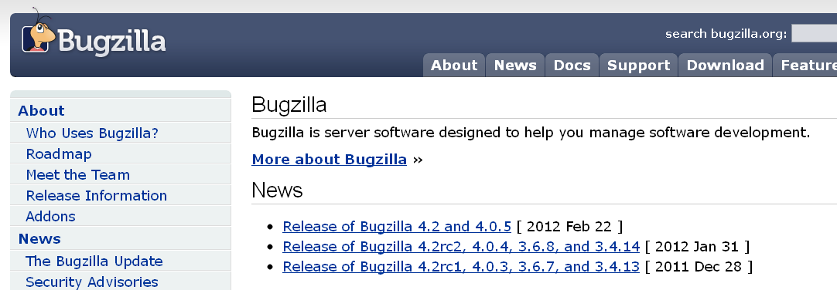
Bug Report
Writing a bug report is one of the most basic and important parts of a tester’s job.
Many projects use Bugzilla (www.bugzilla.org/ ) to track bugs.
In brief, a bug report should include
  Situation: (including OS, component, platform, etc.)
  Bug description:
    Bug Report Title
    Severity (e.g., Crash/Hang/DataLoss; major/minor functional problems)
    Steps to reproduce bug
    Expected result
    Actual result (with screen dump or stack trace preferably)

Slide 10
Guidelines from Bugzilla (1/3)
  Where did you find the bug?
    Product: In which product did you find the bug?
    Component: In which component does the bug exist?
    Platform: On which hardware platform did you find this bug? (e.g. Macintosh, SGI, Sun, PC.)
    OS: On which Operating System (OS) did you find this bug? (e.g. Linux, Windows 7,8,10 Mac OS X)
  How important is the bug?
    Severity: How damaging is the bug?
    Minor, normal, major, critical. [Note that different companies have different scales. ]

Slide 11
Guidelines from Bugzilla (2/3)
  Who will be following up on the bug?
    Assigned To: Which engineer should be responsible for fixing this bug?
    Note: This field is assigned by the project manager after the bug report is submitted.

Slide 12
Guidelines from Bugzilla (2/3)
  What else can you tell the engineer about the bug?
    URL: On what URL did you discover this bug?
    If you encountered the bug on a particular URL, please provide it (or, them) here. If you've isolated the bug to a specific HTML snippet, please also provide a URL for that, too.
    Summary: How would you describe the bug, in approximately 60 or fewer characters?
    Good bug title: "Drag-scrolling any web page crashes Mac builds" is a useful title. "Crash" or "Drag Crash" would be examples of a bad title.

Slide 13
Guidelines from Bugzilla (3/3)
  What else can you tell the engineer about the bug?
  Steps to Reproduce: The minimal set of steps necessary to trigger the bug. Include any special setup steps.
    1) View any web page. (I used the default sample page, resource:/res/samples/test0.html)
    2) Drag-select the page. (Specifically, while holding down the mouse button, drag the mouse pointer downwards from any point in the browser's content region to the bottom of the browser's content region.)

Slide 14
Guidelines from Bugzilla (3/3)
  Actual Results: How the application executed after performing the above steps.
    The application crashed. Stack crawl appended below from MacsBug…
    Macsbug is a low-level debugger (for pre-Mac OSX Operating System)
  Expected Results: What the application should have done, were the bug not present.
    The window should scroll downwards. Scrolled content should be selected. (Or, at least, the application should not crash.)

Slide 15
What Quantify as a Good Bug Report?
Reproducible (Repeatable):
STR – Steps to Reproduce!
every relevant detail you can provide helps.
  If an engineer cannot see it or conclusively prove that it exists, the engineer will probably stamp it “INVALID BUG”, and move on to the next bug.

Slide 16
What Quantify as a Good Bug Report?
Be Specific !!
  The quicker the engineer can isolate the issue to a specific problem, the more likely it’ll be expediently fixed.
  E.g., if you’re crashing on a site, please take the time to isolate what on the page is triggering the crash, and include it as an HTML snippet in the bug report if possible.
  Specific bugs have the added bonus of remaining relevant when an engineer actually gets to them; in a rapidly changing web, a bug report of say "foo.com crashes my browser" becomes meaningless after the site experiences a half-dozen redesigns and hundreds of content changes.

Slide 17
Poor Bug Report Example of Firefox
“My browser crashed. “
“I think I was on foo.com. I think that this is a really bad problem & you should fix it or else nobody will use your browser. “
“By the way, my sister thinks your icons really disgusting. Oh, and my mom's home page doesn't look right, either, it's all messed up. Thx 4 fixing these bugs!”

Slide 18
Good Bug Report Example of Firefox
I crashed each time when I went to foo.com,
using Firefox on a Win NT 4.0 (Service Pack 5) system.
The build ID is 20000609.
I also rebooted into Linux, and reproduced this problem using the 20000608 Linux build.
Therefore it is a common build problem for different OSs.

Slide 19
Good Bug Report Example of Firefox
Firefox crashed each time upon drawing the Foo banner on the top of the page.
I pull apart the page, and discovered that the following image link will crash Firefox reproducibly,
unless you remove the "border=0" attribute: <IMG SRC="http://foo.com/images/topics/topicfoos.gif" width=34 height=44 border=0 alt="News">
- The suspected problem is being isolated and identified with more specific details!

Slide 20
Sample Bug Report for a “Sort” Program in PokerGame
Title: Sorting Error
Description: Incorrect values in the sorted list at integration testing
Vendor: CityU CS Dept Product: PokerGame Versions: 1.1.2
Severity: Critical Updated 2/16/2025
Status: Outstanding Assigned to: Dr. David Brown
Problem:
The program accepts an input “14 11”, and is expected to return “11 14”.
However, the program always shows “0 11”, which is considered wrong.
I have read the code of “shell_sort” and test the “shell_sort” separately using the above input, yet the test results show that the sorting is correct.

Slide 21
Use your “Common Sense”
Debugging Guidelines

Slide 22
Take Home’s Guidelines (1):
General
Find simplest input that will always show bugs
  Usually not the input that revealed existence of bug
Start with data that revealed bug
  Keep pairing it down
  Often leads directly to bug
Binary search is a good thing
  E.g., If a failed run executes N statements, form hypothesize midway (at the statement N/2, and then N/4, N/8, N/16 and so on.)

Slide 23
Take Home’s Guidelines (2):
General
The bug is not where you think it is
  Code Trace
Ask yourself where it cannot be?
  Explain why, design related?
Try simple things first, e.g.,
  Reversed order of arguments
  Spelling of identifiers
  Failure to reinitialize a variable
  Same object vs. equal
  Deep vs. shallow copy
Make sure that you have correct source code version
  Recompile everything
Keep a record of what you’ve tried
  Documentation actually saves your time!

Slide 24
Take Home’s Guidelines (3):
When you have a Good Data Set
Decide what intermediate states to look at
  Predict intermediate values
  If necessary, write code to display states
  Don’t throw this away after finding bug , > Re-Test
Don’t expect to find all the bugs at the first time
  Consider making check points
  Especially when runs take a long time

Slide 25
Take Home’s Guidelines (4):
When the Stepping Through the Code
Reconsider assumptions
  E.g., has the OS changed? Dependent components changed?
Debug the code, not the comments
Start working on documentation
  Way to approach things from a different angle/perspective
When it gets really tough, get help
  We all develop blind spots
  Explaining the problem often helps
Walk away
  Trade latency for efficiency
  One reason to start early
Learn and Avoid your mistakes!

Slide 26
Take Home’s Guidelines (5):
When you find a bug
Ask how it got there
  Careless error
  Misunderstanding
  Language
  Requirements
  Environment
  In attempt to fix something else
  Design vs. coding
Ask if the bug
  Has revealed a symptom of a larger problem
  Has relatives, kids… =)

Slide 27
Take Home’s Guidelines (6):
Fixing Bugs
Don’t rush into anything
  Haste makes waste
Does bug explain all observed symptoms?
  If not, are other symptoms independent?
Should it be fixed in concern with other changes?
  Think about Y2K remediation
What are the consequences of the proposed “fix?”
  Will it break other things?
  Does it allow you tidy other things up?
  Code should not always grow
Make sure that you can get back to where you are
  Version Control

Slide 28
Take Home’s Final Notes
Use Debugging tools to help you.
FindBug : http://findbugs.sourceforge.net/
  Other: PMD、JLint、ESC/Java
  Some tools have been installed in our Eclipse platform, read the plug-in guide in Week 1 for more details.
Search tools from sourceforge.net or the Eclipse market place.
Google is your Best Friend! ☺
Documenting you Bug Reports are must in your Group Project.

